Slide 1
Dynamic time warping
Team 10

Slide 2
Outlines
Dealing with data : 28K files
Code Flow
Desktop application GUI

Slide 3
Dealing with data
Dealing with 26K files in 200 different folders
Loading the data and checking if it’s recorded and segmented well
Remove or fix wrong segmented data if possible
Applying MFCC on the data

Slide 4
Code Flow
Script for loading .wav file and converting it into MFCC
Extracting threshold array
Constructing the confusion matrix
Drawing the error of 5 mismatched words

Slide 5
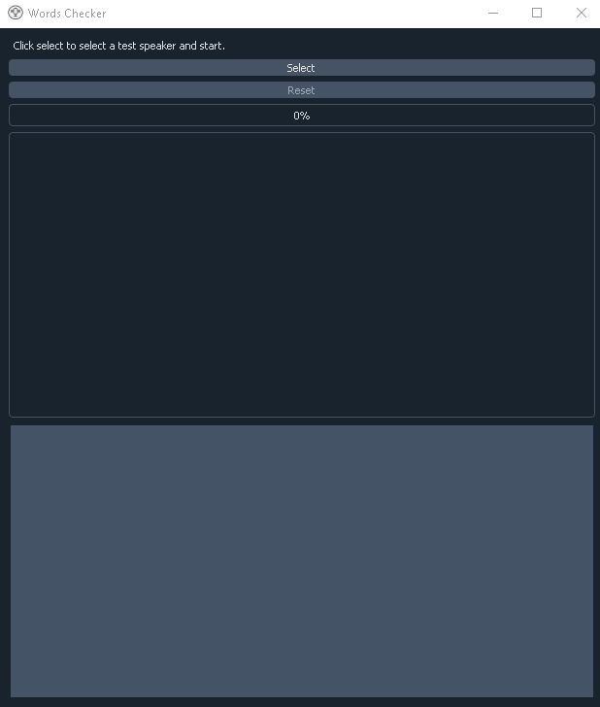
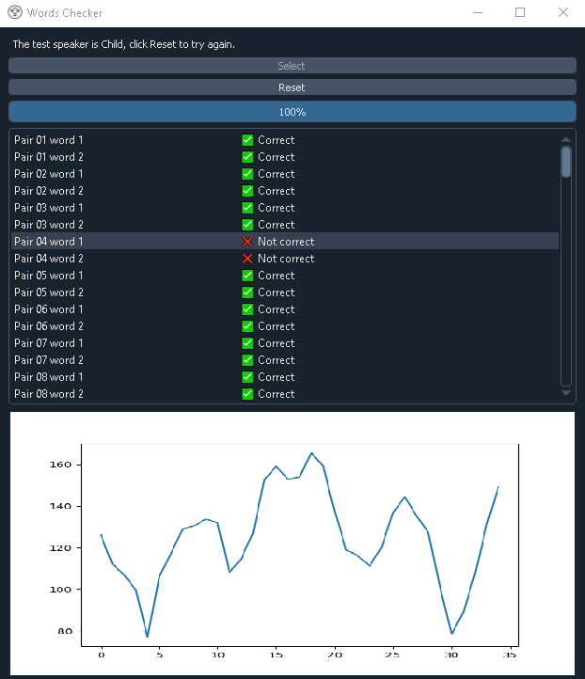
Desktop application GUI

Slide 6
Accuracy
For Males the accuracy is 75.60%
For Females the accuracy is 62.50%
For Children the accuracy is 69.80%

